Slide 1
DISTRIBUTIONS (Made EASY]
Presenters:
BADAR SYED
Vani Kamisetty
Praveen Sequeira

Slide 2
BINOMIAL DISTRIBUTION
BADAR SYED

Slide 3
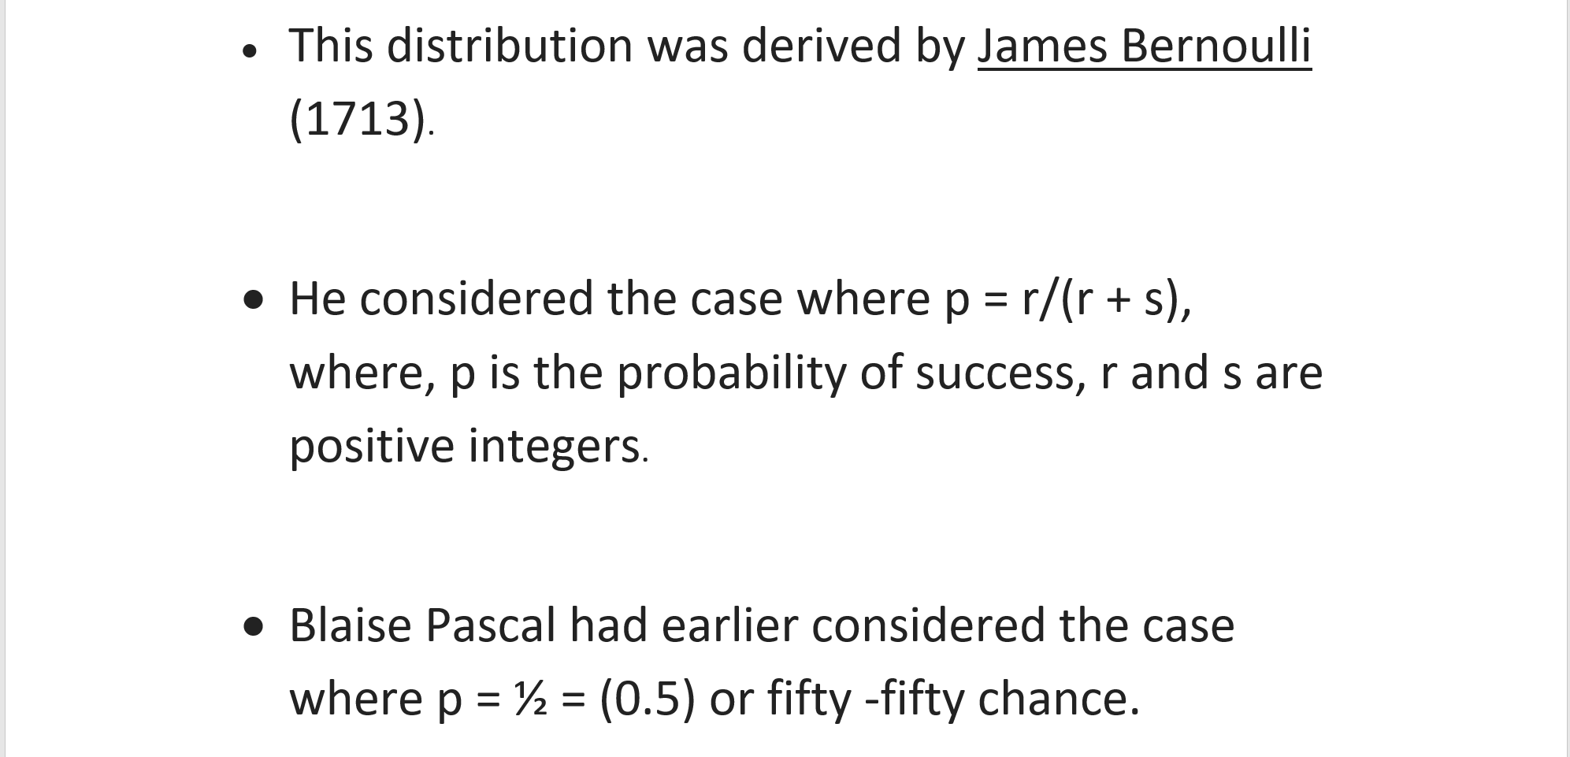
WHERE DO WE START/BACKGROUND

Slide 4

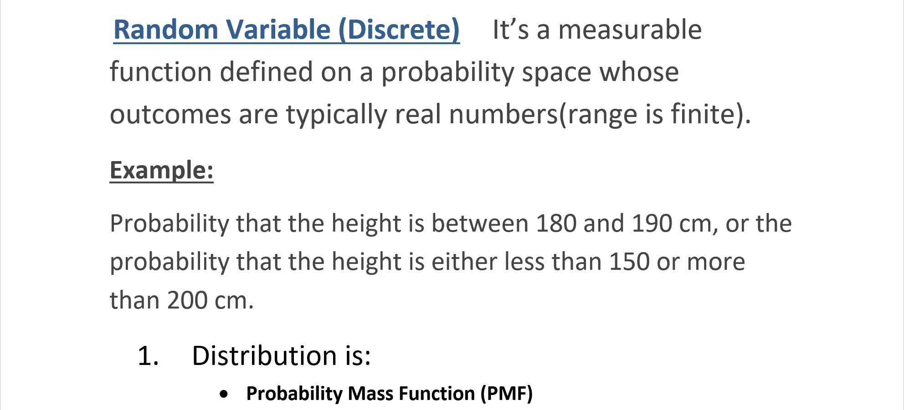

Slide 5
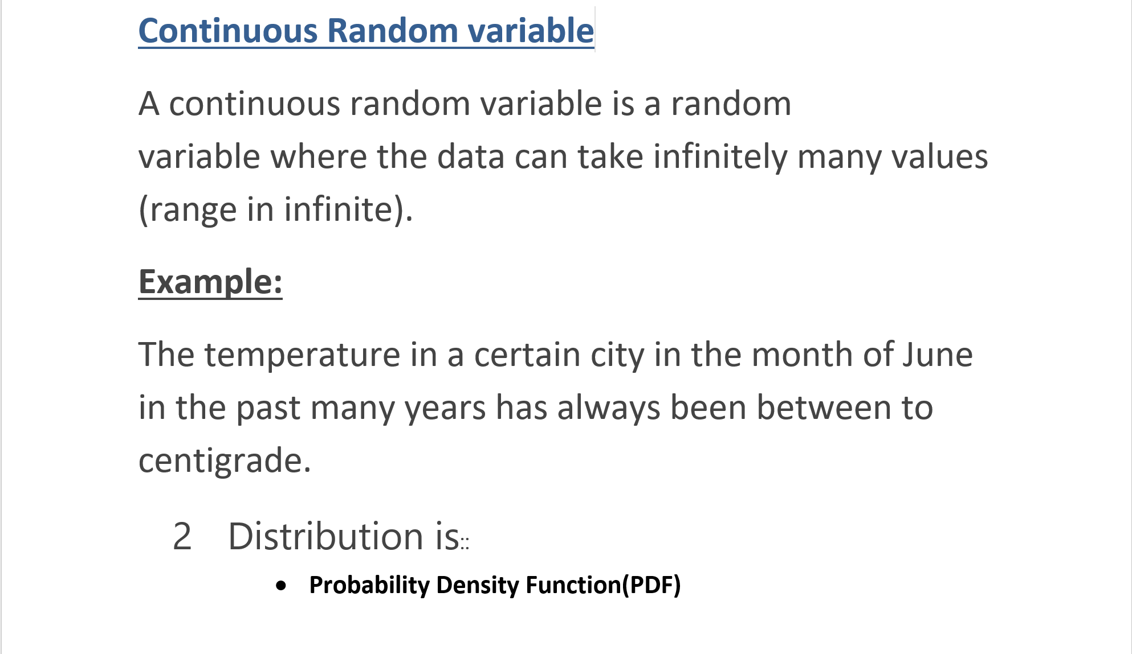

Slide 6
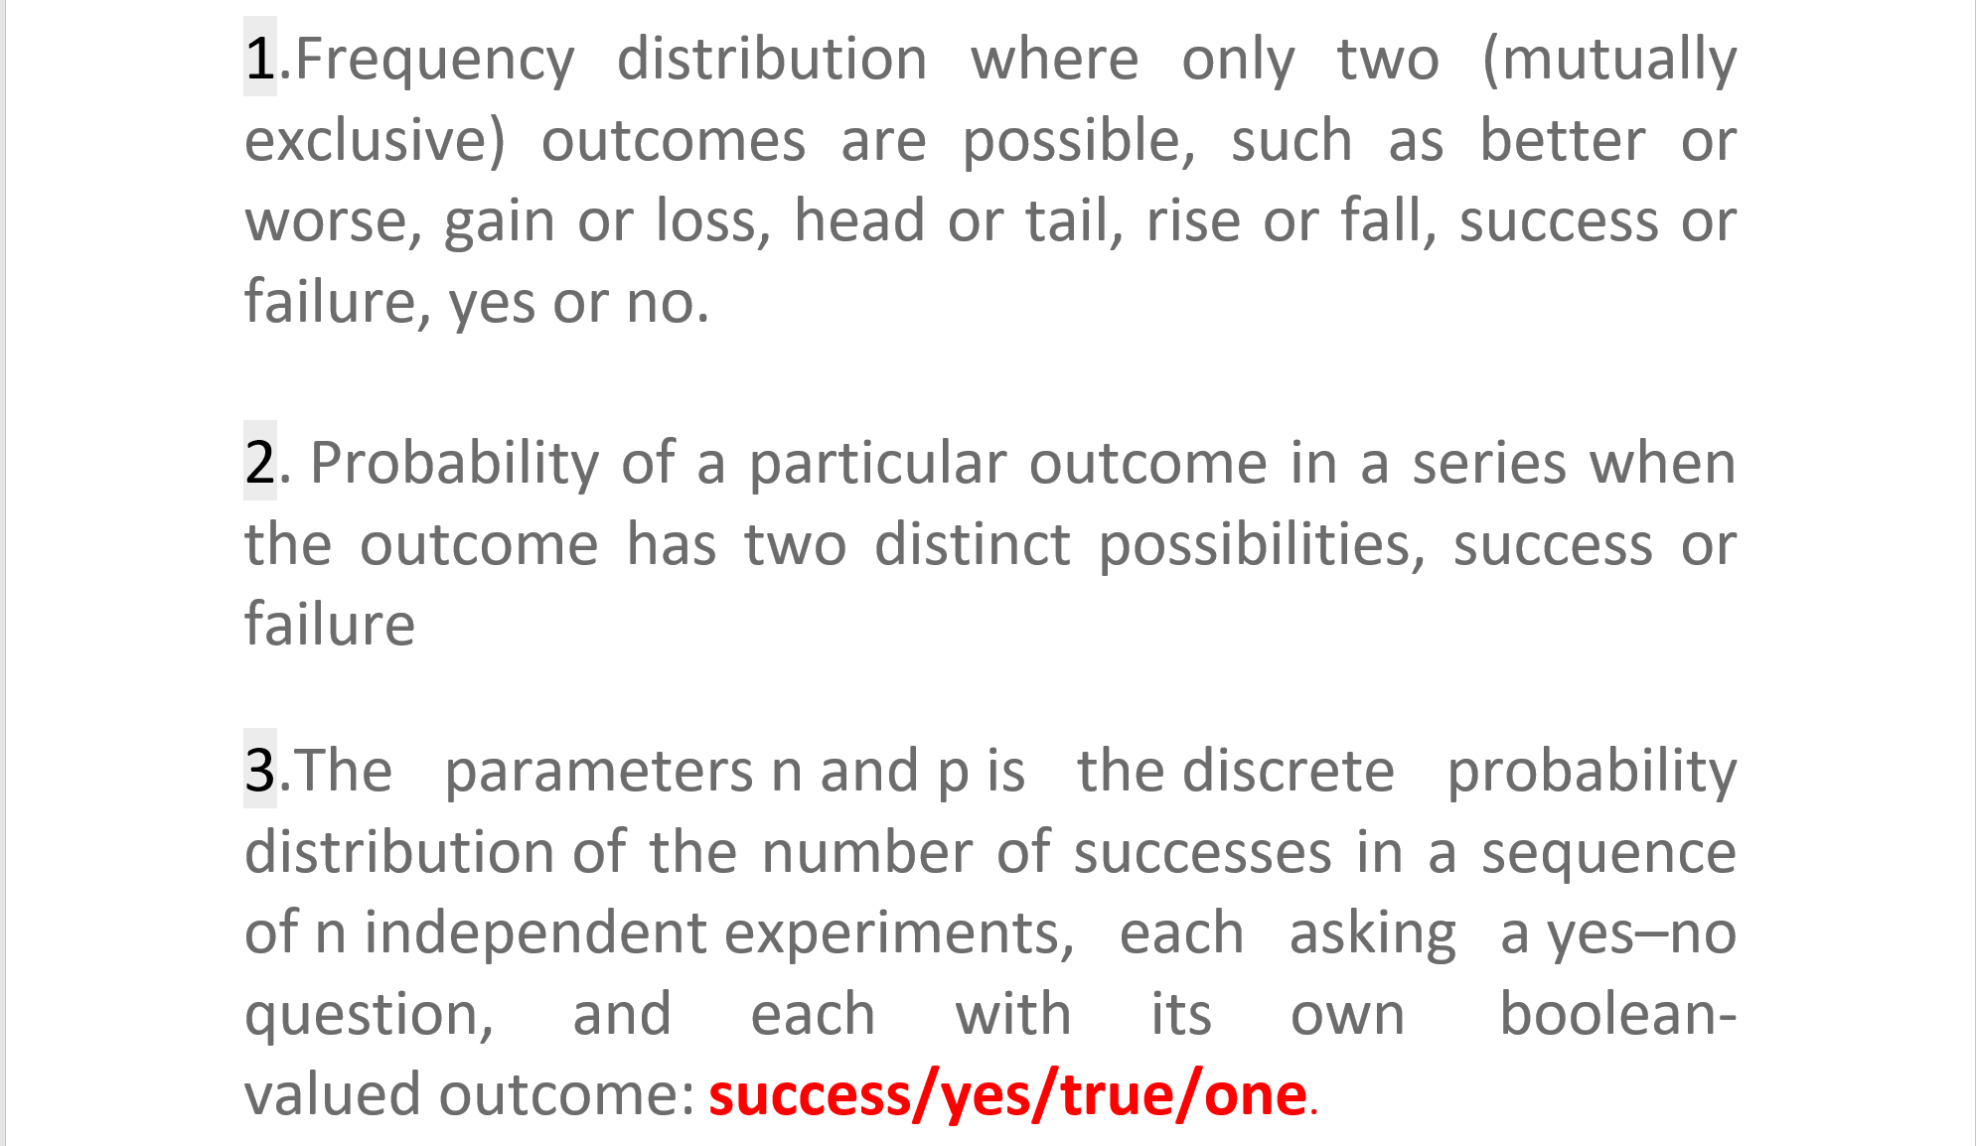
DEFINITION

Slide 7
OR
Bernouli Distribition::
failure/no/false/zero ( q = 1 − p). A single success/failure experiment with a sequence of outcomes i.e., n = 1, this binomial distribution is a Bernoulli distribution.
Negative BD or GD
Number of failures before the first success; is a special case of the negative binomial distribution

Slide 8
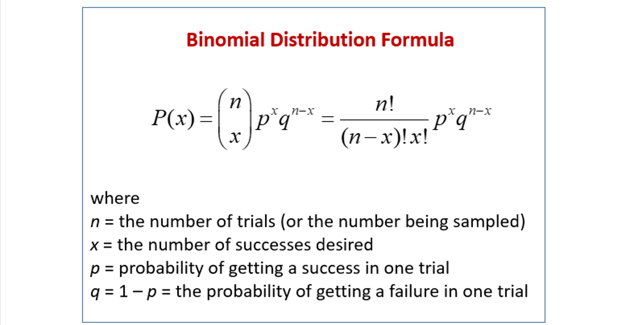
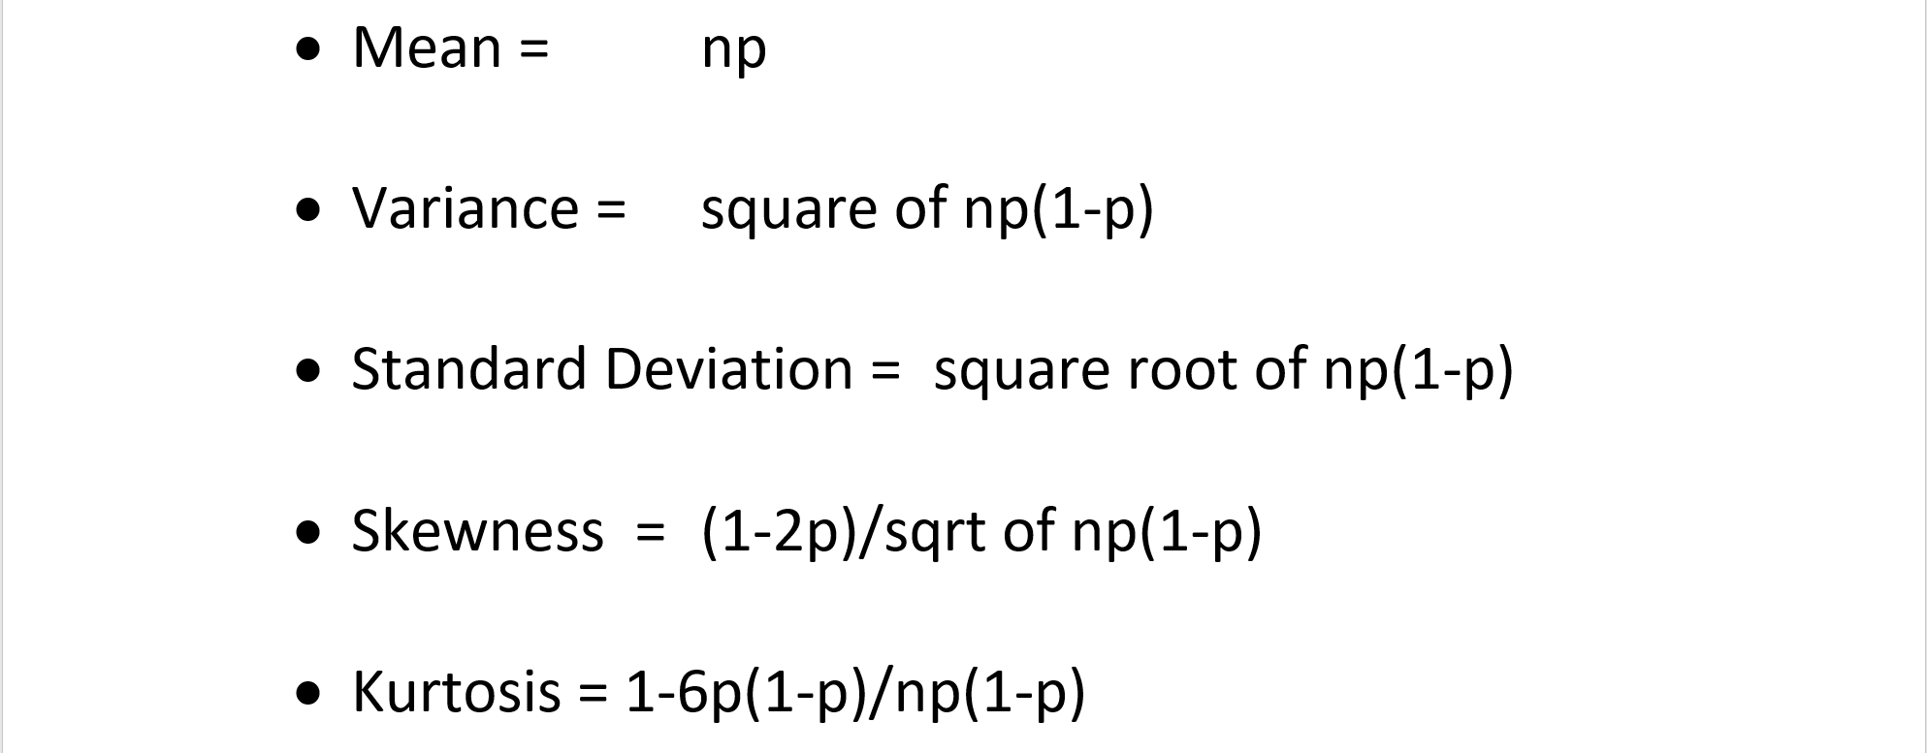

Slide 9
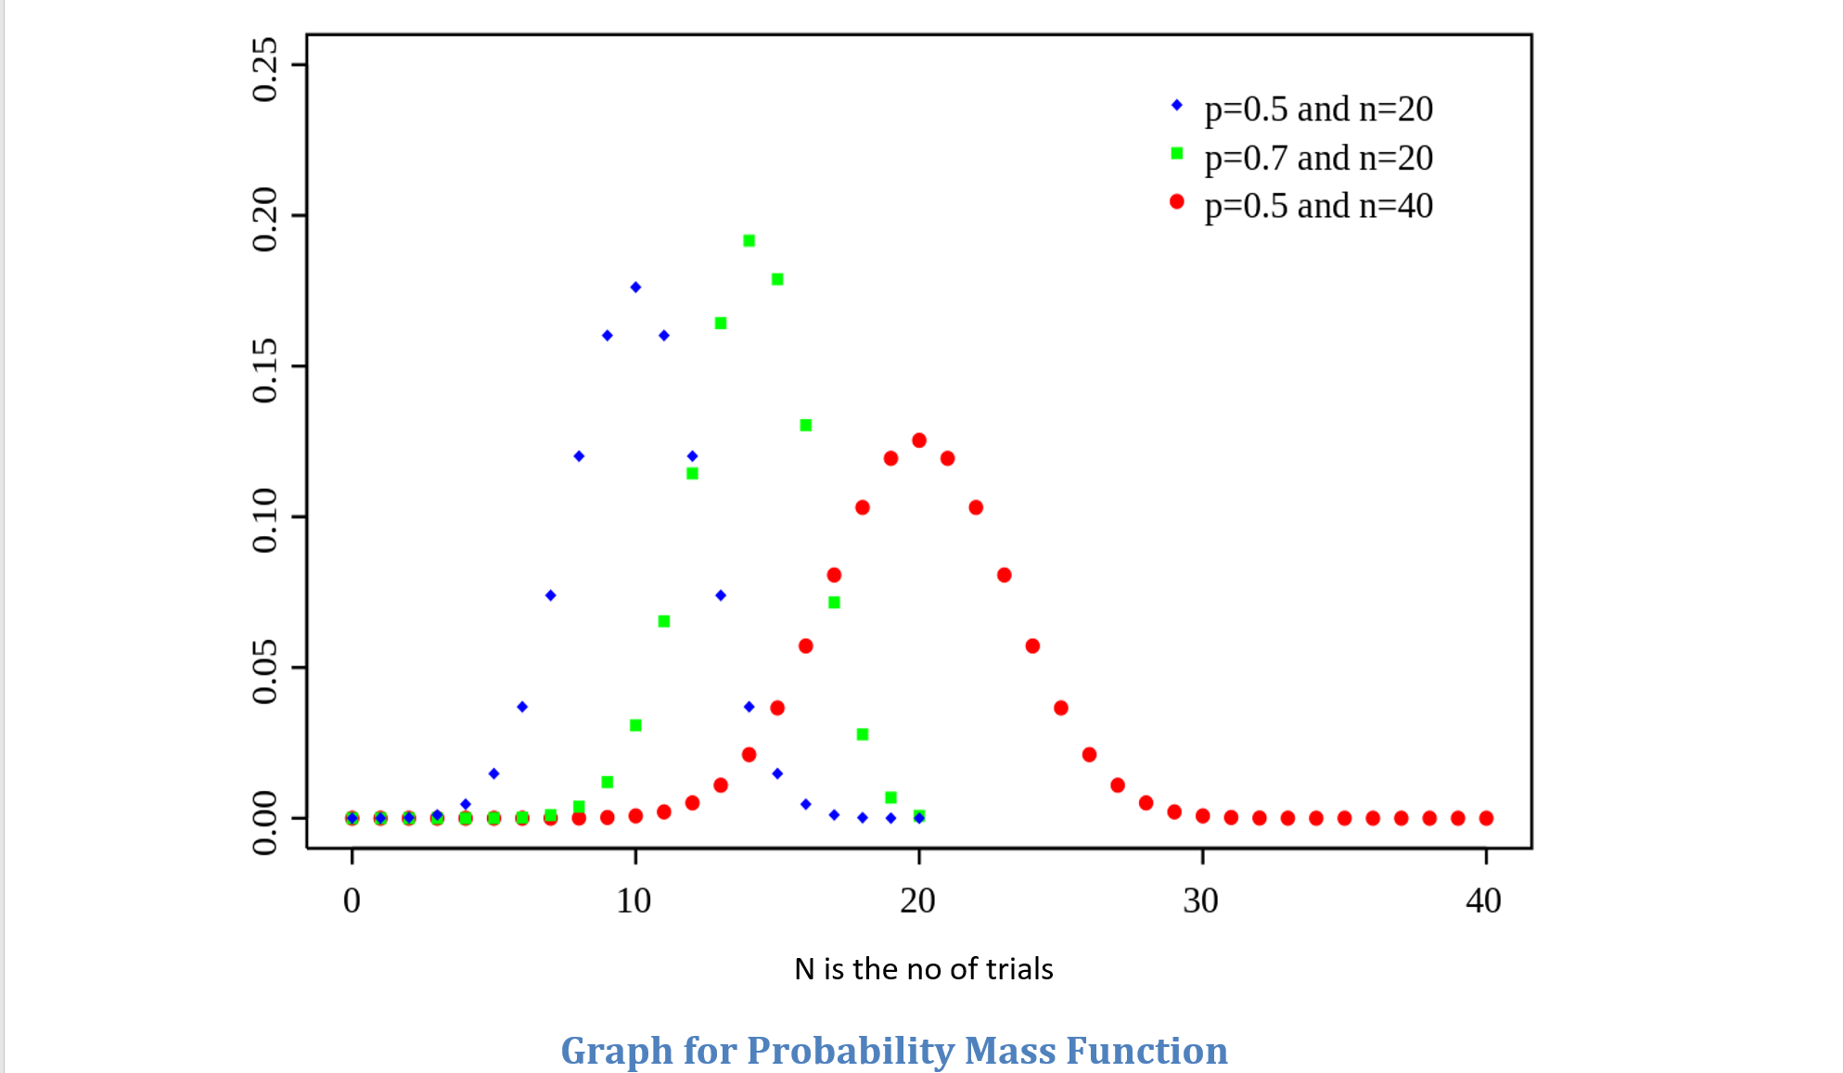
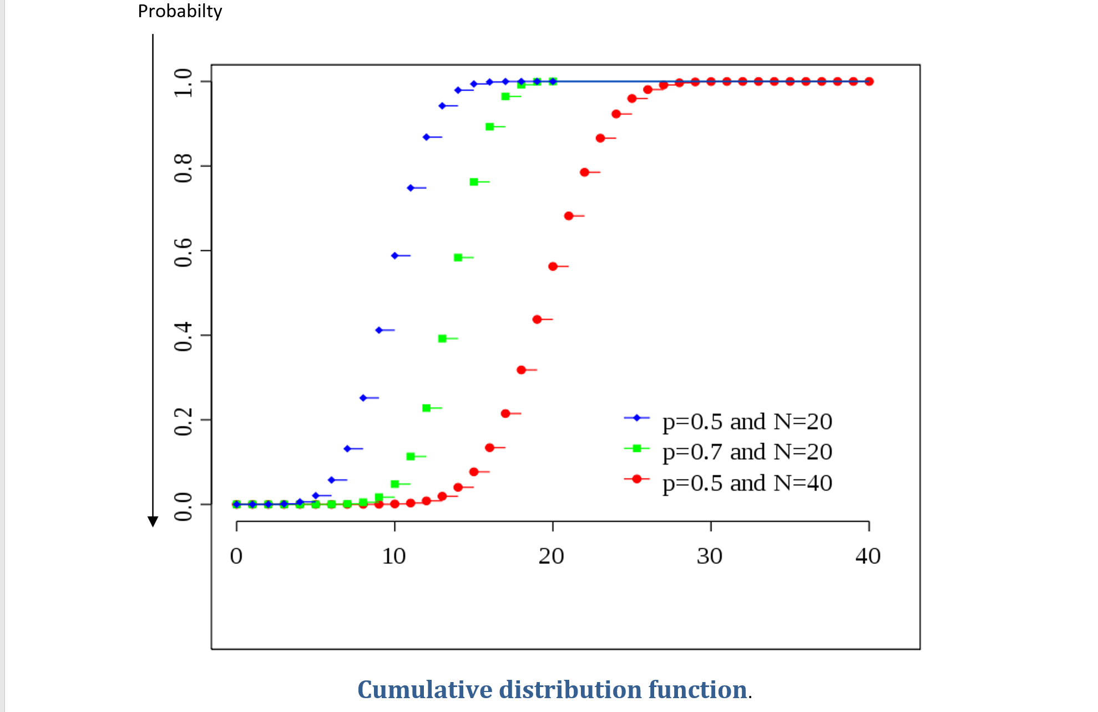

Slide 10
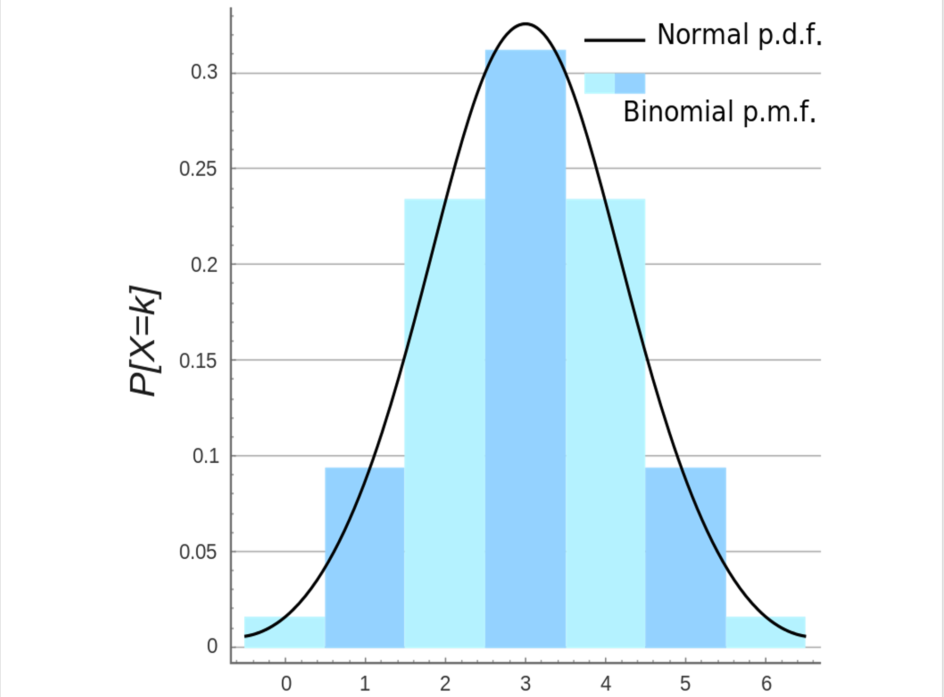
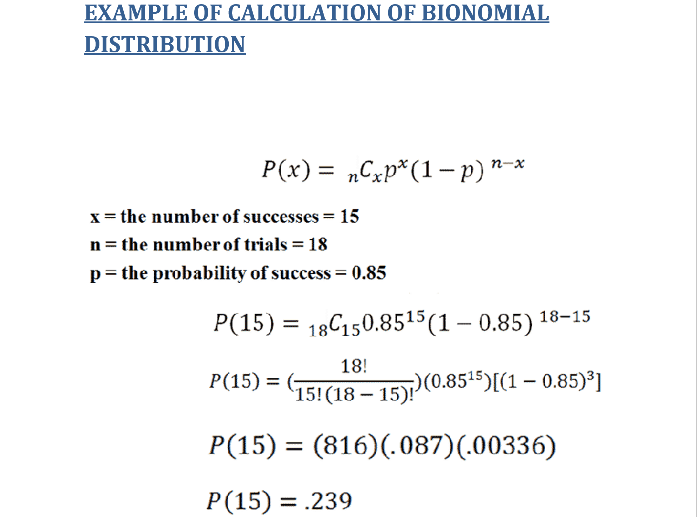

Slide 11
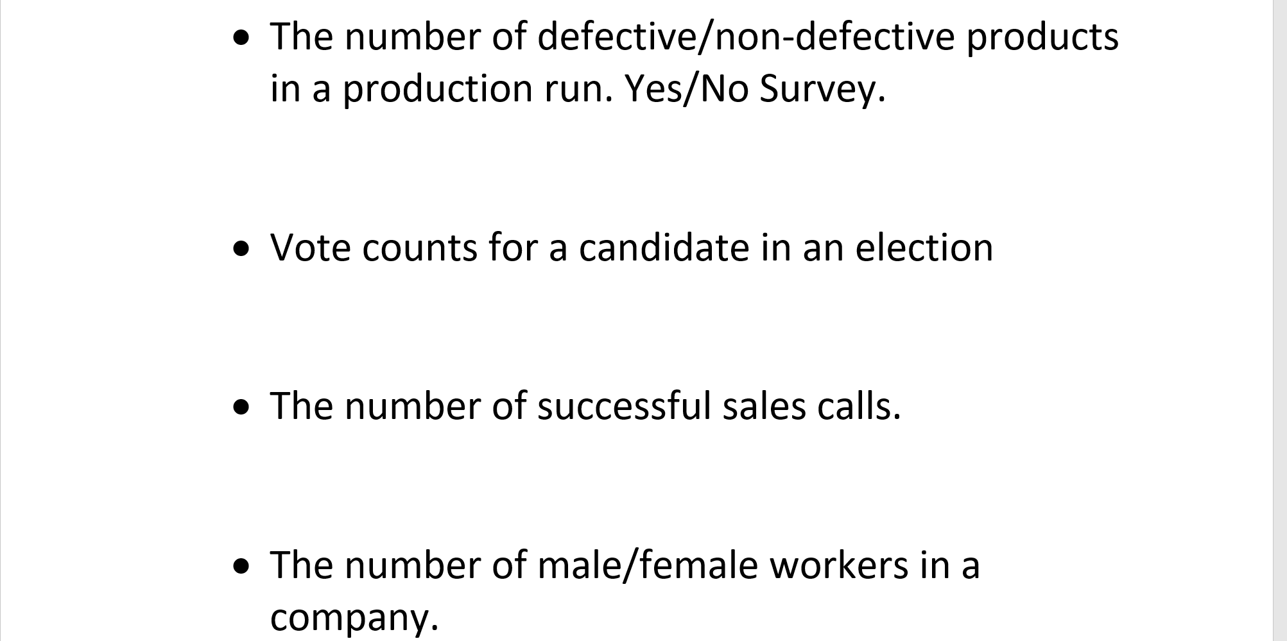
BINOMIAL DISTRIBUTION EXAMPLES (in real life)

Slide 12
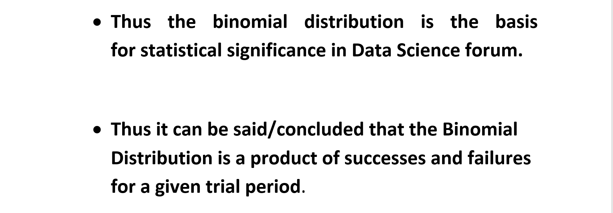
CONCLUSION

Slide 13
POISSON DISTRIBUTION
Vani Kamisetty

Slide 14
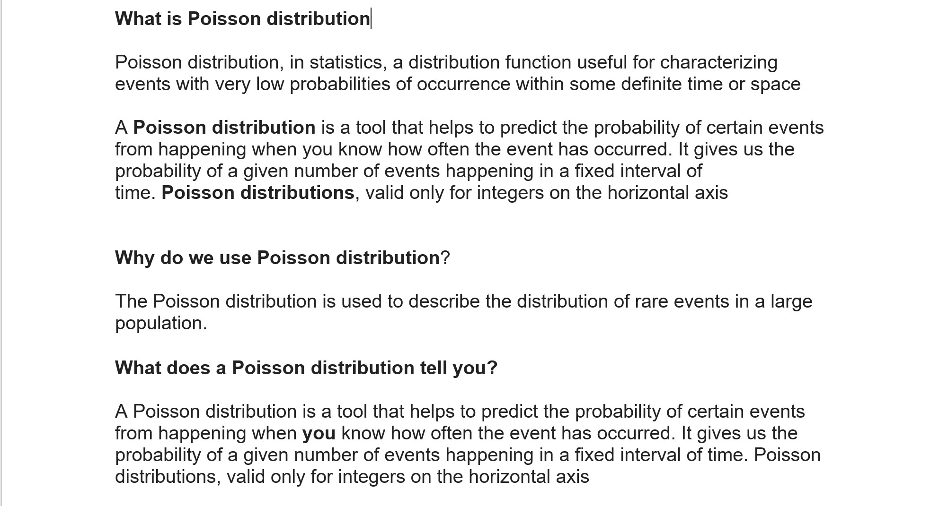

Slide 15
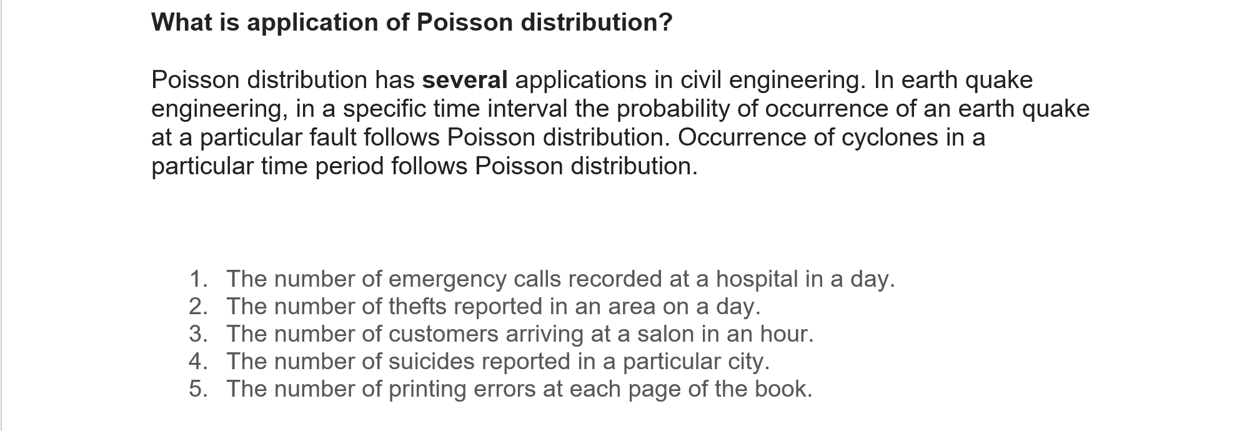

Slide 16
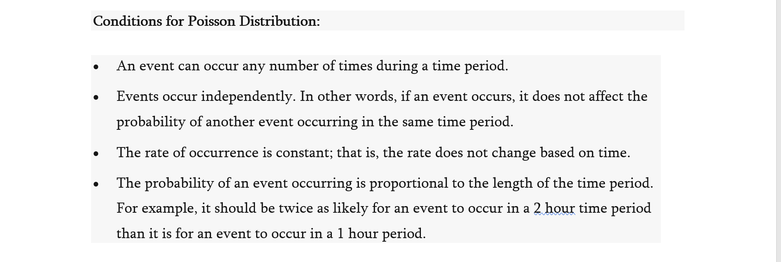

Slide 17
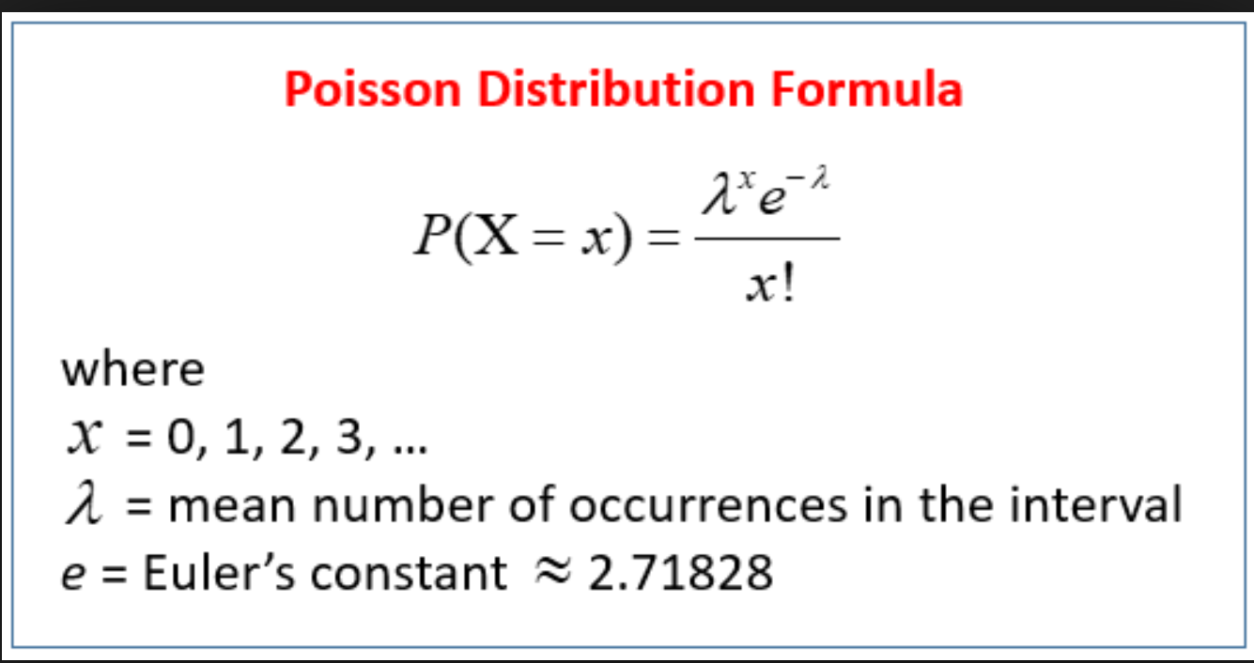

Slide 18
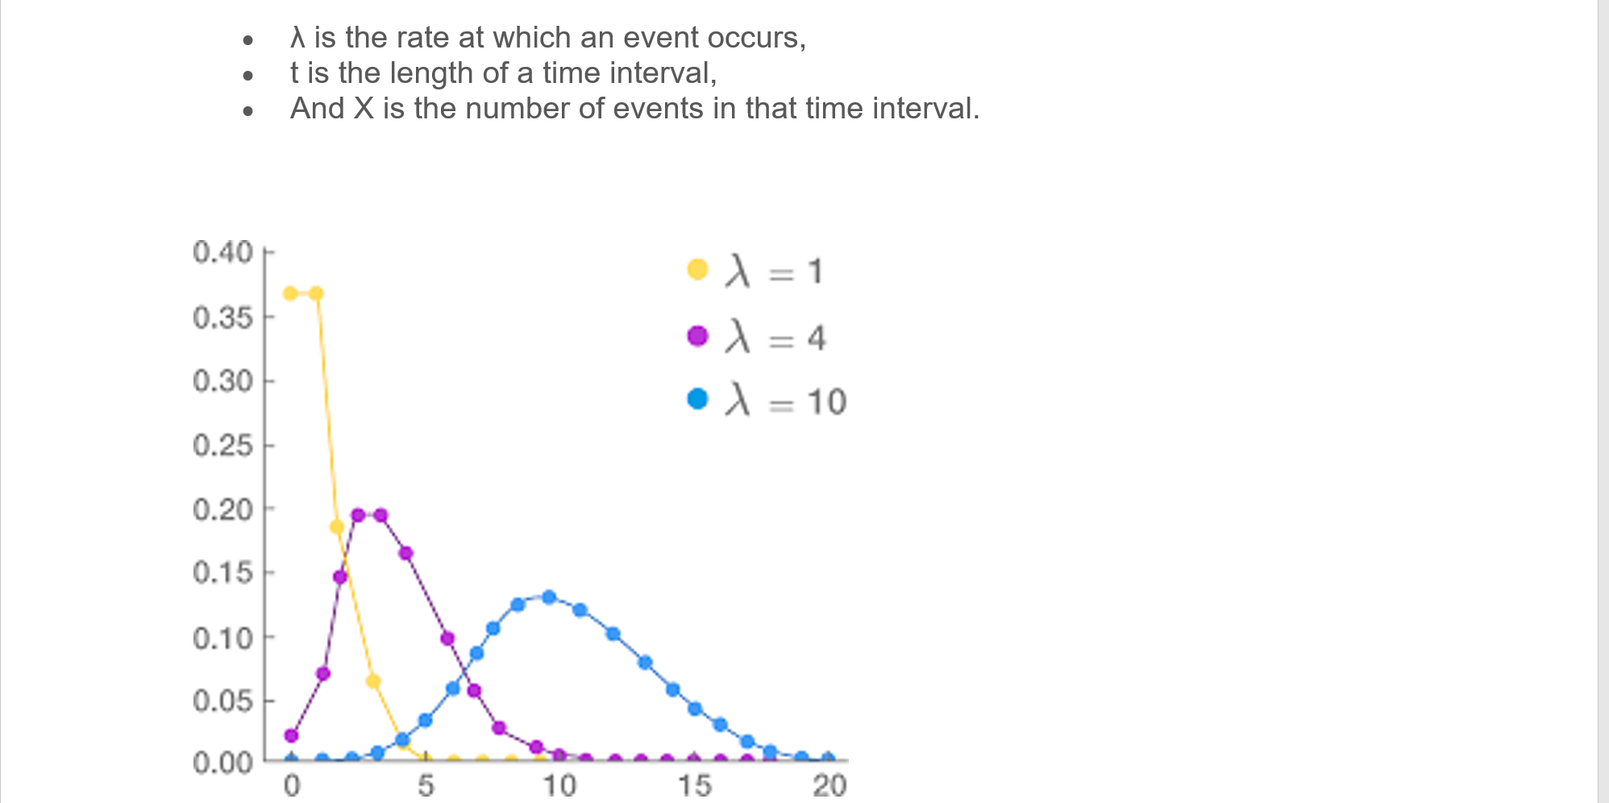

Slide 19
CenTRAL LIMIT THEOREM
Praveen Sequeira

Slide 20



Slide 21



Slide 22



Slide 23


Slide 24
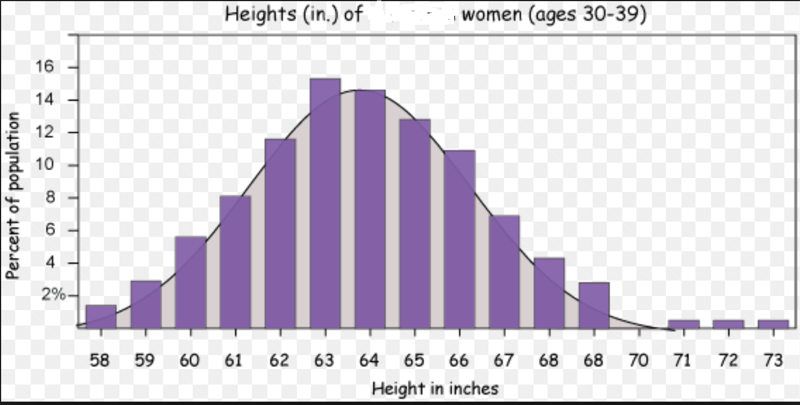

Slide 25
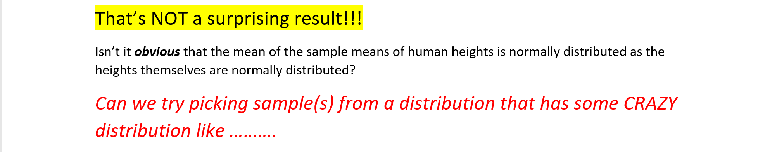
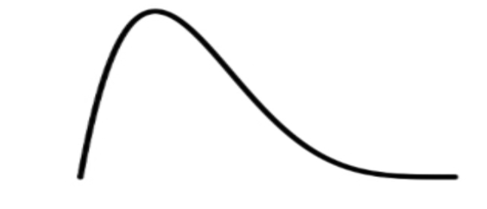


Slide 26

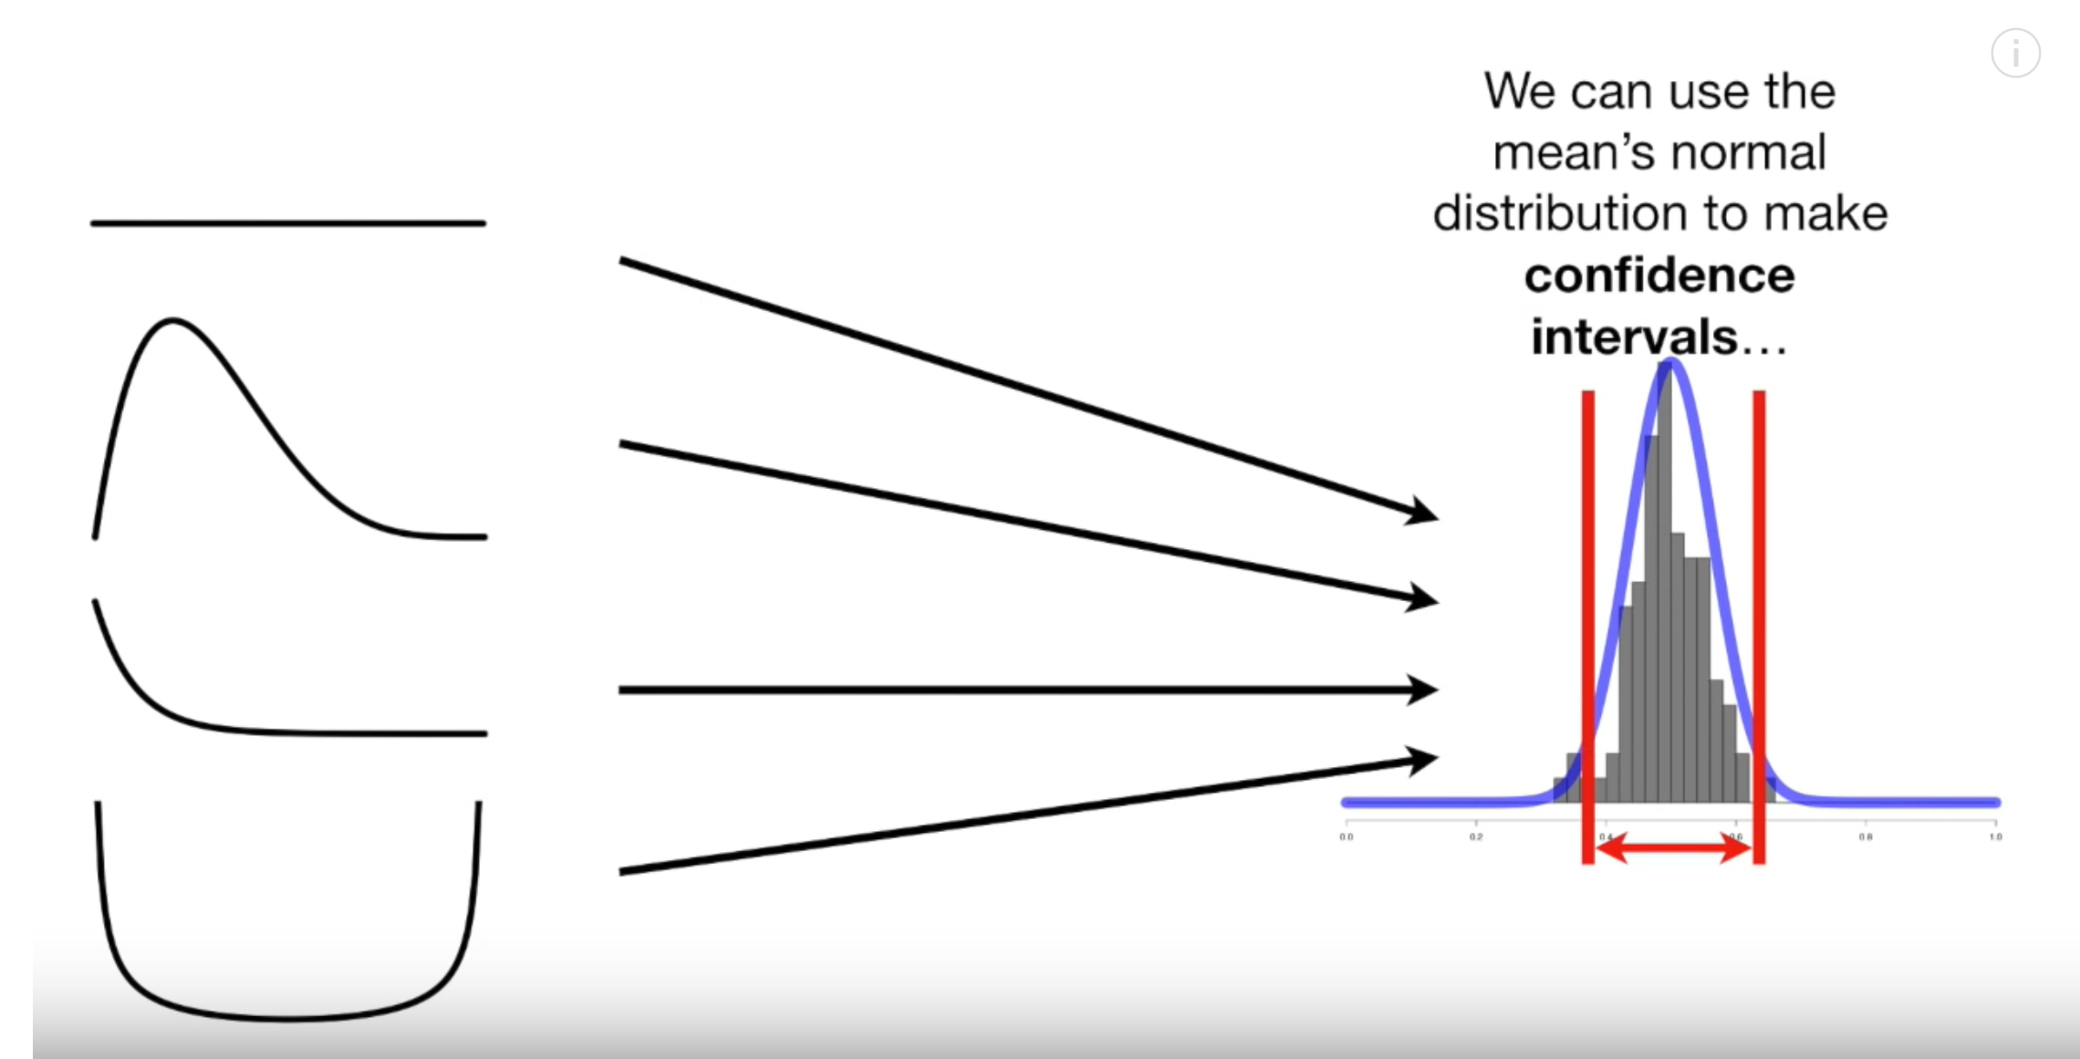

Slide 27

Hacker statistics To the rescue!!

Slide 28



Slide 29
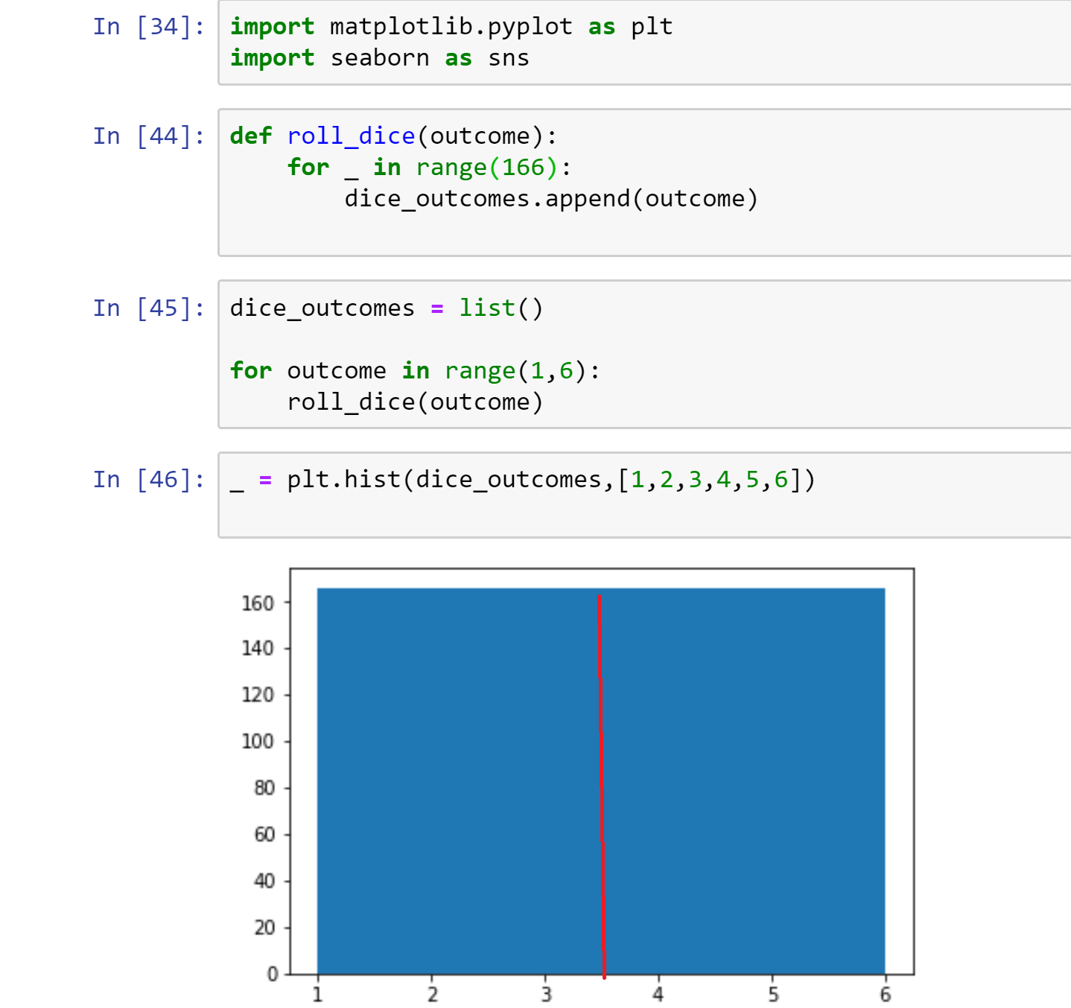

Slide 30

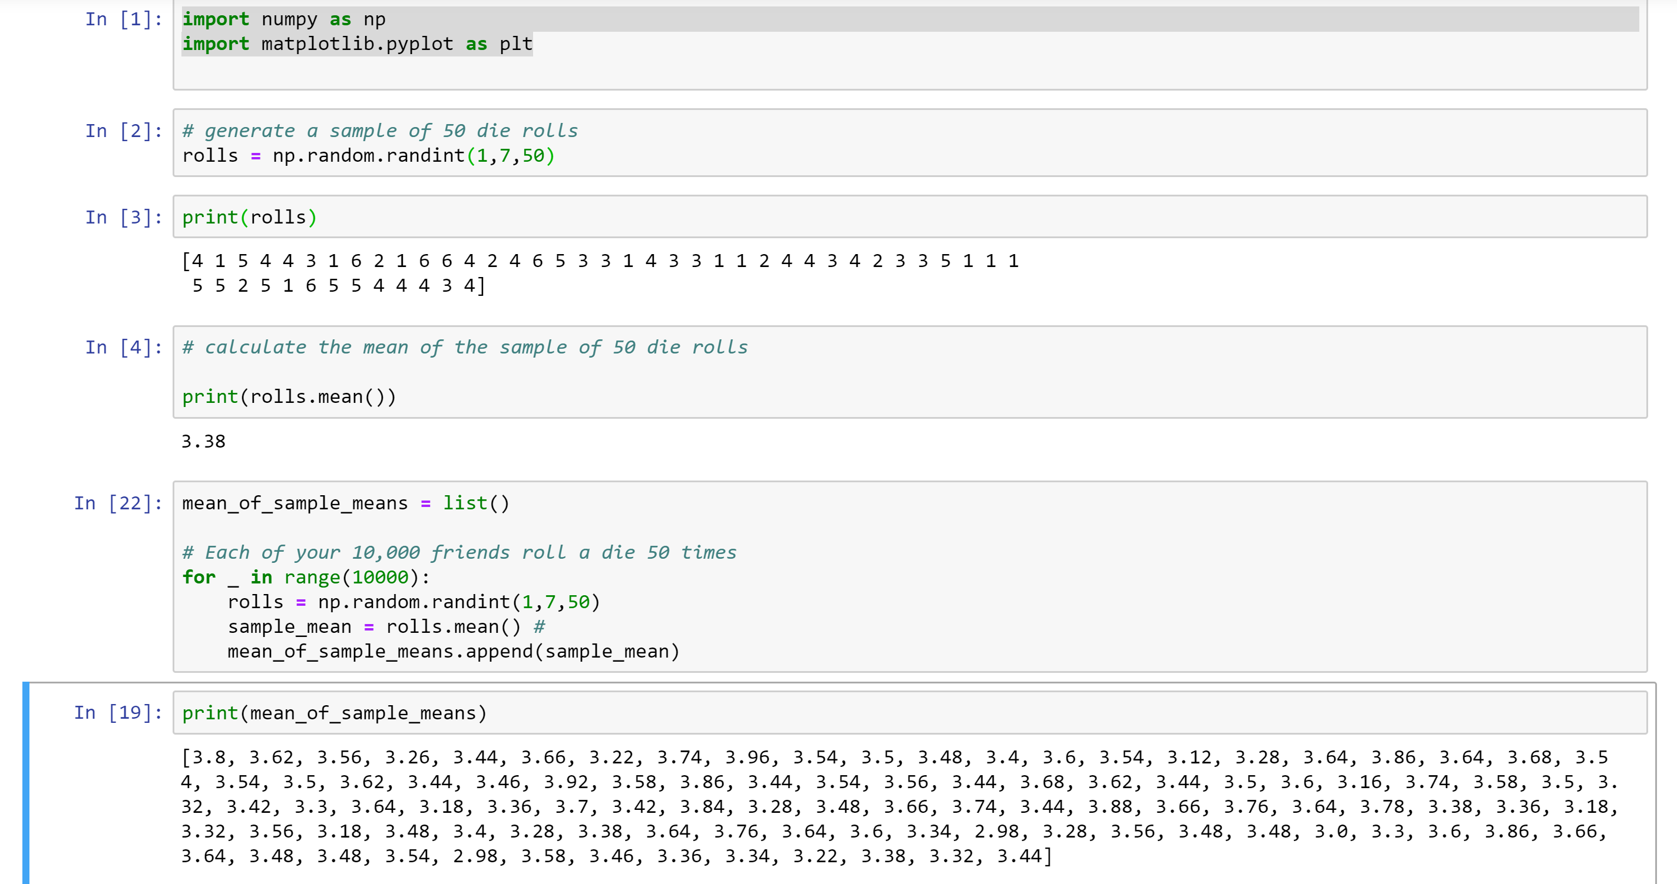

Slide 31
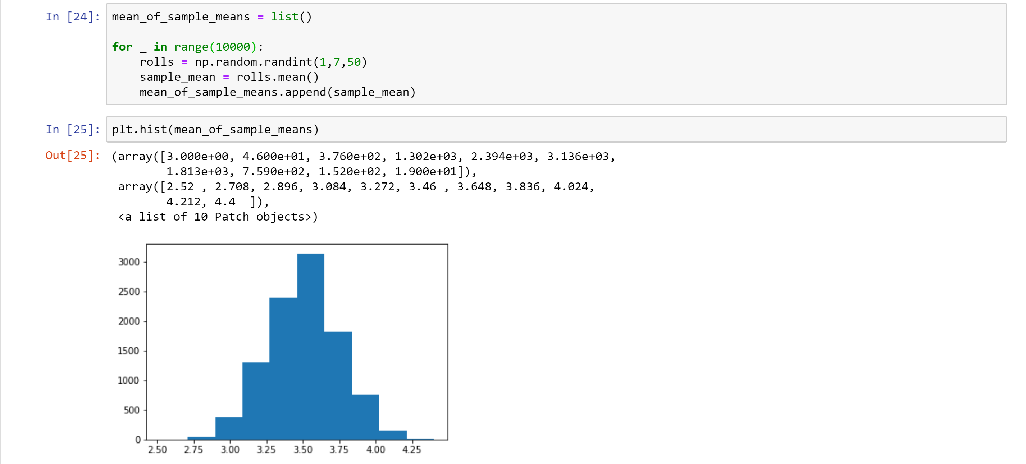

Slide 32
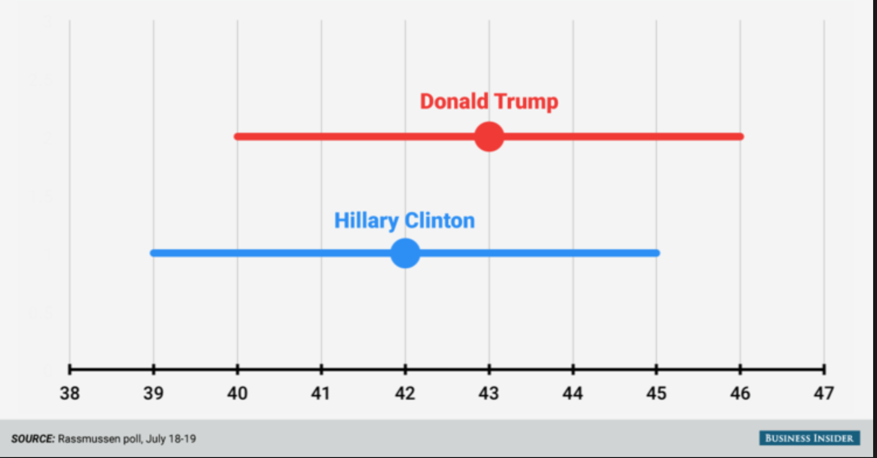
Confidence INTERVAL

Slide 33
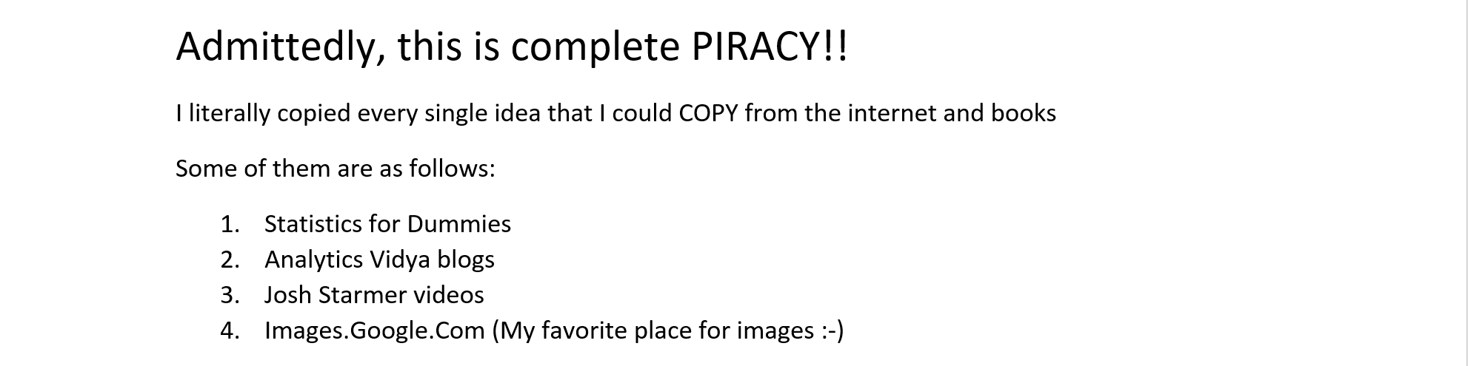
Sources

Slide 34


